Slide 1



SOFTWARE DEVELOPMENT PROFESSIONAL PROGRAM
Best Practices

Slide 2





Best Practices
Learning Objectives
Differentiate between a relative and an absolute file path.
Differentiate between local file paths and paths that reference a web resource.
Describe what CDNs are and what kinds of resources typically are hosted on CDNs.

Slide 3
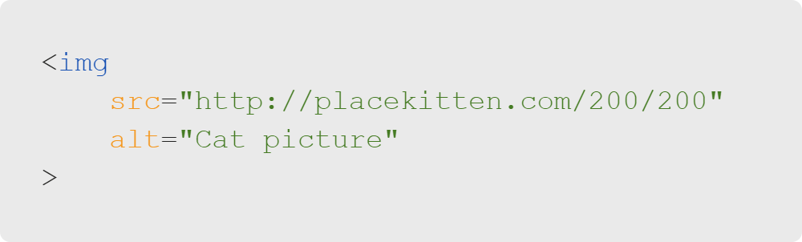
Best Practices
Review: Images
src attribute accepts a file path.
placekitten.com is a website that hosts images.

Slide 4

Best Practices
Remote Paths
This is a remote resource.
placekitten.com/200/200 refers to an image that lives on the web.
Notes:
<< Refer to LC exercise 1: Remote Paths >>

Slide 5

Best Practices
Local Paths
We can use local file paths, too.
Let's say Jane Doe wants to use a picture of her cat from her laptop.
Image Source (Creative Commons License)

Slide 6
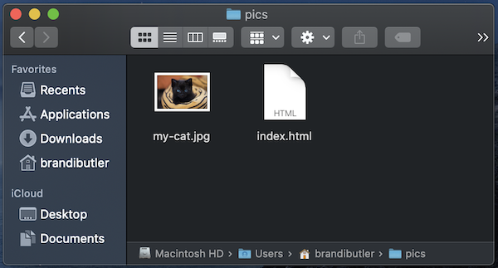
Best Practices
Local Paths
Notes:
As we can see in Jane's file system, the cat picture exists in the same folder as her HTML page.

Slide 7

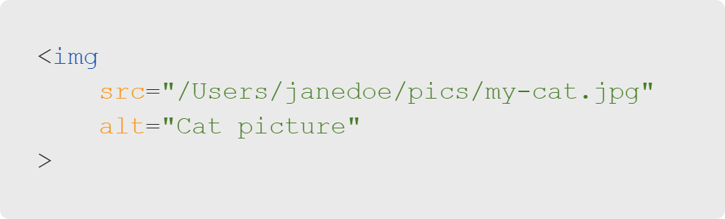
Best Practices
Absolute Paths
Inside index.html
Notes:
One way Jane can access her image is via an absolute path. This path doesn't change based on where
the HTML file lives. It refers to the "absolute" location of the cat image on her machine.

Slide 8
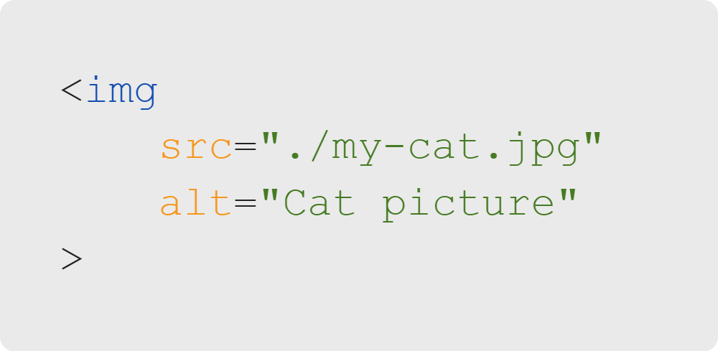
Best Practices
Relative Paths
Inside index.html
Note: "." indicates the current folder.
Notes:
Because of the proximity of her HTML and image files, Jane may want to use a relative link.

Slide 9
Best Practices
Relative Paths
Relative paths work even after Jane publishes her website.
Image and HTML files still exist in the same relative position!
Notes:
Recall in the intro course how we published some code on GitHub Pages? GitHub Pages acted as our server!

Slide 10

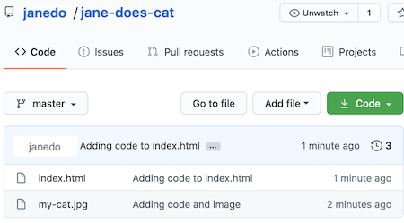

Best Practices
Relative Paths
Same format on GitHub Pages (server)
File system on Jane's computer
Notes:
Relative paths are preferred because the relationships between files persist between machines, but
an absolute path is really only good for the machine it's on.
<< Refer to LC exercise 2: Relative Paths >>

Slide 11
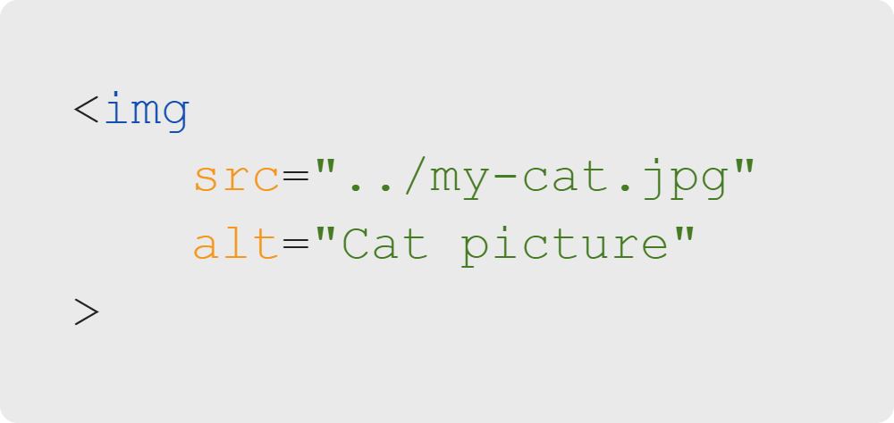
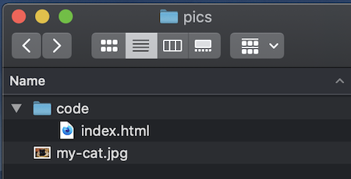
Best Practices
Let's Rearrange
We'll change the path in src.
my-cat.jpg is now in a folder above index.html.
Note: ".." indicates the parent folder.
Notes:
We can navigate around our file system the same way we navigate on our terminal-by using "." for
the current folder and ".." for the parent folder.
<< Refer to LC exercises 3 & 4: Quiz >>

Slide 12
Best Practices
Absolute vs. Relative
! Potential Pitfall
Once the page is published on the web, paths on Jane's laptop don't make sense. Think about why.
Is Jane using an absolute or relative path?
Does the relationship between file persist on both machines?

Slide 13

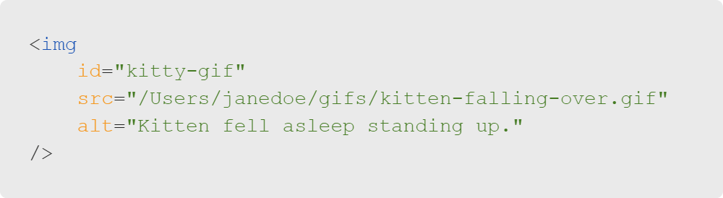
Best Practices
Quiz: Multiple Choice
Which answer best describes the src file path?
A. Relative + local
B. Absolute + local
C. Relative + remote
D. Absolute + remote

Slide 14
Best Practices
Quiz: Multiple Choice Answers
Which answer best describes the src file path?
🚫 A. Relative + local
✅ B. Absolute + local
🚫 C. Relative + remote
🚫 D. Absolute + remote

Slide 15
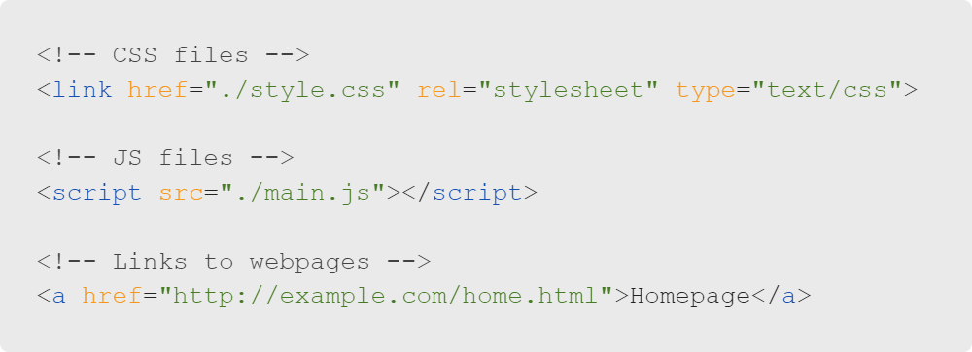
Best Practices
CDNs
Images aren't the only thing we link to.
CSS files
JavaScript files
Webpage links
And more!

Slide 16
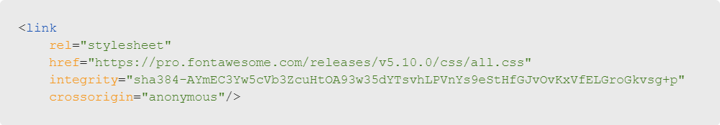
Best Practices
CDNs
An example of a content delivery network (CDN):
Notes:
Recall our previous activity where we made a layout based on the Microsoft website? For the icons, we
linked to a remote file that provided the Font Awesome icons.

Slide 17
Best Practices
CDNs
What is a CDN?
Stands for Content Delivery Network
Cache of content, such as icons, images, etc., close to end users
What does a CDN do?
Allows for quick transfer of assets needed to loading Internet content.
Enables resource use without being hosted directly
Reduces bandwidth costs
If configured properly, helps protect websites against some common malicious attacks.

Slide 18
Best Practices
Quiz: Multiple Choice
Which of the following is NOT a benefit of using a CDN?
A. Reduced server load
B. Increased reliability
C. Control over content
D. Efficient loading

Slide 19
Best Practices
Quiz: Multiple Choice Answers
Which of the following is NOT a benefit of using a CDN?
🚫 A. Reduced server load
🚫 B. Increased reliability
✅ C. Control over content
🚫 D. Efficient loading
Actually, we don't control the content at all!
Most likely, our CDN keeps its content on many servers throughout the world. We neither own nor maintain it.
Notes:
CDNs host very specific content most of the time.
We don't control the content; it's a take it or leave it situation!

Slide 20

Best Practices
Activity Time
Let's practice!
Notes:
Let's get some hands-on experience now.

